Slide 1

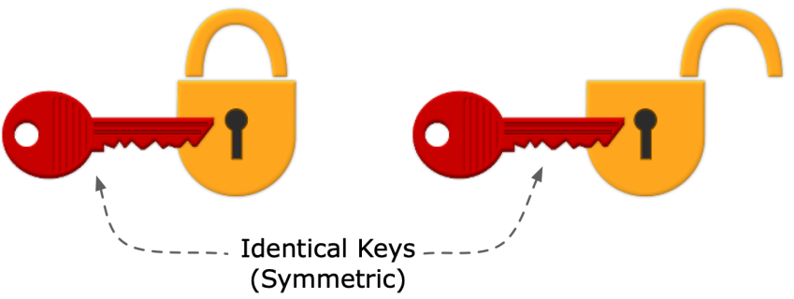
Module II Chapter 1: Conventional Symmetric Key Encryption

Slide 2

Block Ciphers And Stream Ciphers
Symmetric encryption ciphers consist of two main categories:
Block Ciphers And Stream Ciphers.
Understanding the difference between a block cipher vs. stream cipher is kind of like the difference between watching a movie on DVD or via a streaming service. Sure, both will give you the entertainment you seek, but they each work differently in terms of mechanics and speed.
Block and stream ciphers are two ways that you can encrypt data. Also known as Bulk Ciphers, they’re two categories of Symmetric encryption algorithms.
Block and stream ciphers are two separate routes to the same end goal of securing your data.

Slide 3
Encrypting information in chunks- A block cipher breaks down plaintext messages into fixed-size blocks before converting them into cipher text using a key.
Encrypting information bit-by-bit- A stream cipher, on the other hand, breaks a plaintext message down into single bits, which then are converted individually into cipher text using key bits.
Block ciphers are the algorithms that form the backbone of many of the cryptographic technologies and processes that are in use today in computer communications.
Where stream ciphers are concerned, you’ll find stream ciphers in use in:
SSL/TLS connections
Bluetooth connections
Cellular and 4G connections

Slide 4
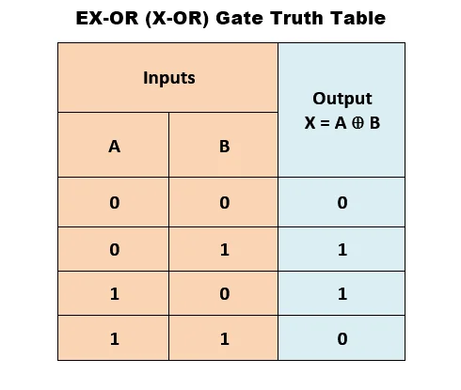
XOR Operations in Cryptography
‘⊕’ This is known as an XOR, or what stands for the “exclusive - or” logical operation.
Stream ciphers use bitwise XOR operators on binary data as part of their encryption and decryption processes.
So, what XOR does is compare two input bits and generate a single output bit. It’s a way to check for error among other things.
If both bits match, it returns a 0 (false); if they don’t match, it returns a 1 (true).

Slide 5
What Is a Block Cipher?
As the name would imply, a block cipher is one that allows you to use a key to encrypt data in big blocks groups of a pre-determined size (such as 128 bits, 256 bits, etc.).
So, what this does is allow you to encrypt all the data in a block as a single unit.
For example, let’s say you have the message: “For the Alliance.”
If you want to encrypt that using a block cipher, the plaintext message would be broken down into smaller blocks of binary.
So, “For the Alliance” would look something like this:
0100011001101111011100100010000001110100011010000110010100100000010000010110110001101100011010010110000101101110011000110110010100101110

Slide 6
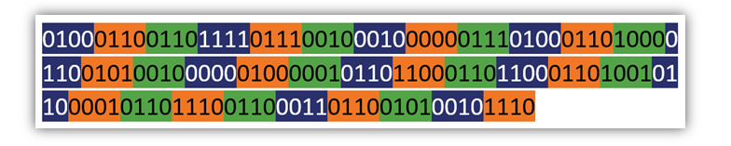
Now, if we break these 136 binary digits into blocks of, say, 4 digits, it divides nicely because 4 goes into 136 a total of 32 times. The blocks would look something like this:
But what do you do if the there isn’t enough data to form a complete block? Like, say, if you had 138 binary digits instead of 136 (meaning you’d have an incomplete last data block)?
Then what you can do is add padding (this could be a set number of 0s) to the end of the block to ensure the block is that fixed size.

Slide 7
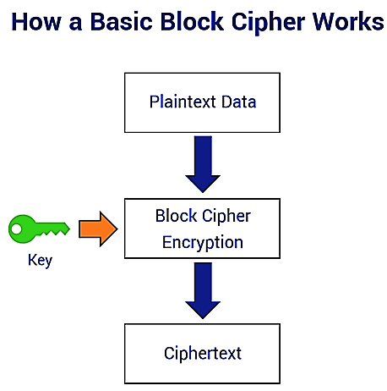

Slide 8
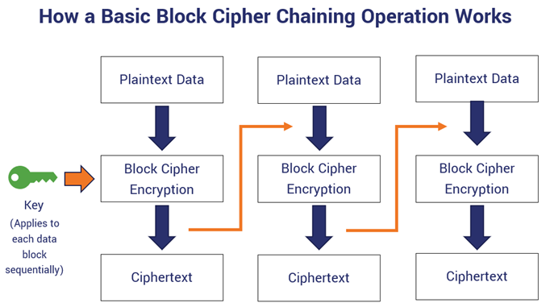

Slide 9

Examples of Block Ciphers
Data Encryption Standard (DES),
Triple DES (3DES or TDEA),
Advanced Encryption Standard (AES),
International Data Encryption Algorithm (IDEA),
Blowfish,
Twofish,
RC5
Advantages:
Block Ciphers are difficult to mess with in terms of inserting symbols.
They’re highly analyzed and studied by cryptographers, which means that people smarter than you and me have attempted to break them.

Slide 10
What Is a Stream Cipher?
Unlike block ciphers, which require the formation of blocks prior to encryption, stream ciphers encrypt data in long, pseudorandom streams.
Basically, this means you can process one bit of data at a time instead of waiting for a data block to form.
Two types of stream ciphers:
Synchronous stream ciphers (key auto-key, or KAK)
These types of ciphers generate key streams independently of any previous plaintext or cipher texts.
Self-synchronizing stream ciphers (asynchronous stream ciphers, cipher text auto key or CTAK)
These ciphers, on the other hand, rely on previous cipher text bits to generate key streams.

Slide 11
How Stream Ciphers Work?
A stream cipher encrypts data one bit at a time instead of in blocks. But a key part of this process is generating a stream of pseudorandom bits based on an encryption key and a seed/a nonce (a unique randomly generated number — “nonce” = number-only-used-once).
Together, they create a key stream (that stream of pseudorandom bits we just mentioned) that gets XORed with your plaintext input, which encrypts it and results in your cipher text output.
This rinse-and-repeat process happens over and over again with each bit of plaintext data.
However, it’s important to not use the same exact key-nonce combination again because it can result in a duplicate key stream.

Slide 12
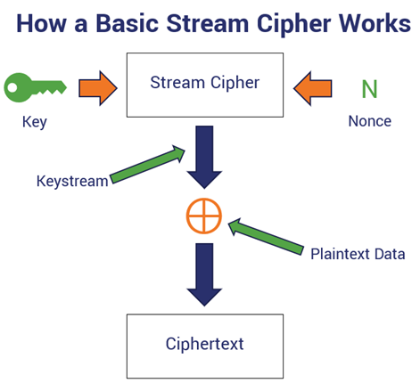

Slide 13
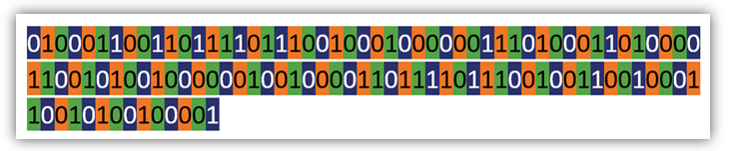
Example:
This is a basic illustration to showcase the basic operations of a stream cipher.
“For the People!”
0100011001101111011100100010000001110100011010000110010100100000010010000110111101110010011001000110010100100001
So, if we use a stream cipher to encrypt the message, we’ll do so one bit at a time.
So, the plaintext data would be broken down into individual bits, which would look something like this:

Slide 14
Examples of Stream Ciphers:
Salsa20 (software and hardware implementations),
ChaCha20 (the modified version of Salsa20; ChaCha20 is supported in TLS 1.3),
RC4 (for wireless networks),
A5 (for GSM cellular networks).

Slide 15
Block Cipher modes of Operation
Block Cipher Modes of Operation define how to securely encrypt and decrypt large amounts of data using a block cipher.
However, to encrypt data larger than a single block, different modes of operation are used to ensure both security and efficiency.
Here are a few common modes:
Electronic Code Book (ECB)
Cipher Block Chaining(CBC)
Cipher Feedback Mode (CFB)
Output Feedback Mode(OFB)
Counter Mode

Slide 16
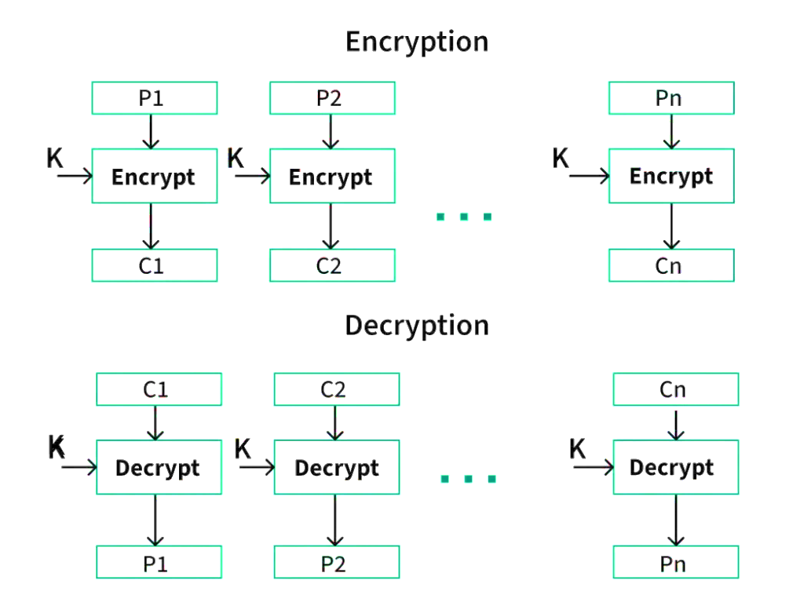
Electronic Code Book (ECB)
The electronic codebook is the easiest block cipher mode of functioning.
It is easier because of the direct encryption of each block of input plaintext and output is in the form of blocks of encrypted cipher text.
Generally, if a message is larger than b bits in size, it can be broken down into a bunch of blocks and the procedure is repeated.

Slide 17
Advantages:
Parallel encryption of blocks of bits is possible, thus it is a faster way of encryption.
Simple way of the block cipher.
Disadvantages:
Prone to cryptanalysis since there is a direct relationship between plaintext and cipher text.
Identical plaintext blocks produce identical cipher text blocks, which can reveal patterns.

Slide 18
Cipher Block Chaining (CBC)
Cipher block chaining or CBC is an advancement made on ECB since ECB compromises some security requirements.
In CBC, the previous cipher block is given as input to the next encryption algorithm after XOR with the original plaintext block.
Here, IV is a random or unique value used in combination with a secret key to initialize the encryption process.
In a nutshell here, a cipher block is produced by encrypting an XOR output of the previous cipher block and present plaintext block.

Slide 19
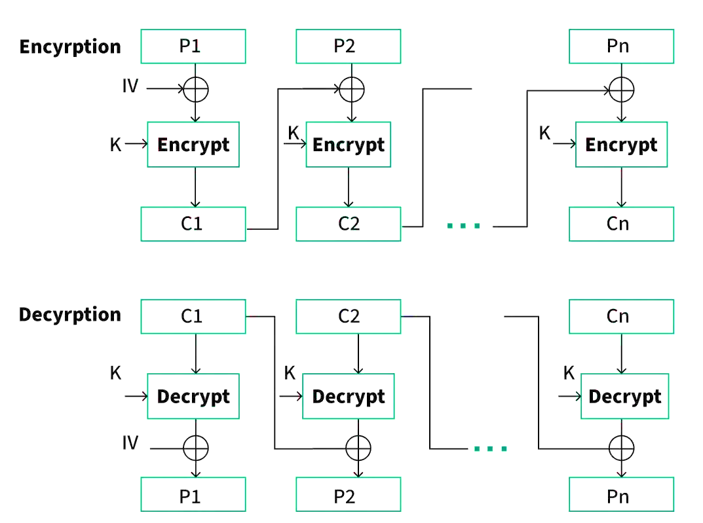

Slide 20
Advantages:
CBC works well for input greater than b bits.
CBC is a good authentication mechanism.
Better resistive nature towards cryptanalysis than ECB.
More secure than ECB as it hides patterns.
Disadvantages:
Requires the previous cipher text block for encryption and decryption, making parallel processing difficult.

Slide 21
Cipher Feedback Mode (CFB)
In this mode the cipher is given as feedback to the next block of encryption with some new specifications:
first, an initial vector IV is used for first encryption and output bits are divided as a set of s and b-s bits.
The left-hand side s bits are selected along with plaintext bits to which an XOR operation is applied.
The result is given as input to a shift register having b-s bits to LHS, s bits to RHS and the process continues.

Slide 22
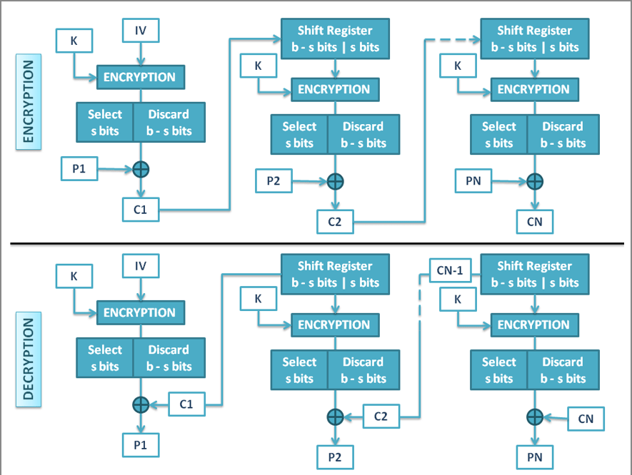

Slide 23
Advantages:
Since, there is some data loss due to the use of shift register, thus it is difficult for applying cryptanalysis.
Can handle data streams of any size.
Disadvantages:
The drawbacks of CFB are the same as those of CBC mode. Both block losses and concurrent encryption of several blocks are not supported by the encryption. Decryption, however, is parallelizable and loss-tolerant.
Slightly more complex and can propagate errors.

Slide 24
Output Feedback Mode(OFB)
The output feedback mode follows nearly the same process as the Cipher Feedback mode except that it sends the encrypted output as feedback instead of the actual cipher which is XOR output.
In this output feedback mode, all bits of the block are sent instead of sending selected s bits.
The Output Feedback mode of block cipher holds great resistance towards bit transmission errors.
It also decreases the dependency or relationship of the cipher on the plaintext.

Slide 25
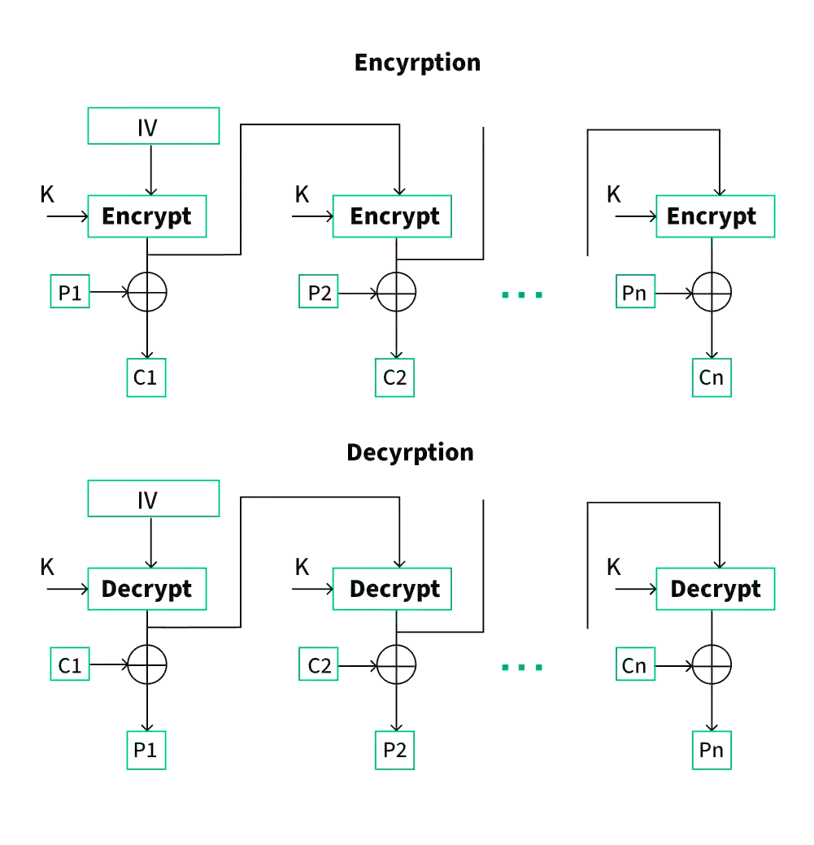

Slide 26
Advantages:
In the case of CFB, a single bit error in a block is propagated to all subsequent blocks. This problem is solved by OFB as it is free from bit errors in the plaintext block. Thus errors in transmission don’t propagate.
Disadvantages:
The drawback of OFB is that, because to its operational modes, it is more susceptible to a message stream modification attack than CFB.
If the key stream is reused, security is compromised.

Slide 27
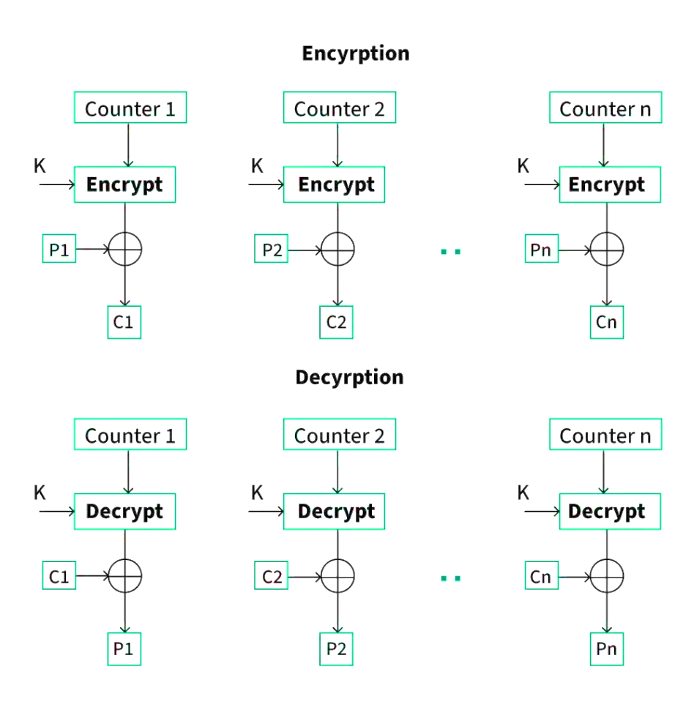
Counter Mode(CTR)
The Counter Mode or CTR is a simple counter-based block cipher implementation.
Every time a counter-initiated value is encrypted and given as input to XOR with plaintext which results in cipher text block.
The CTR mode is independent of feedback use and thus can be implemented in parallel.

Slide 28
Advantages:
Since there is a different counter value for each block, the direct plaintext and cipher text relationship is avoided. This means that the same plain text can map to different cipher text.
Parallel execution of encryption is possible as outputs from previous stages are not chained as in the case of CBC.
Disadvantages:
The fact that CTR mode requires a synchronous counter at both the transmitter and the receiver is a severe drawback. The recovery of plaintext is inaccurate when synchronization is lost.
Applications of Block Ciphers
Data Encryption
File and Disk Encryption
Virtual Private Networks (VPN)
Secure Sockets Layer (SSL) and Transport Layer Security (TLS)
Digital Signatures

Slide 29
Other Modes of Operation
GCM (Galois/Counter Mode)
CCM (Counter with CBC-MAC)
XTS (XEX Tweakable Block Cipher with Cipher text Stealing)
EAX Mode
OCB (Offset Codebook Mode)
PCBC (Propagating Cipher Block Chaining)
LRW (Liskov, Rivest, Wagner) Mode

Slide 30
Feistel Cipher Structure (S-P network)
Claude Shannon introduced idea of substitution-permutation (S-P) networks. Form basis of modern block ciphers
S-P nets are based on the two primitive cryptographic operations seen before:
Substitution (s-box)
Permutation (p-box)
Provide confusion & diffusion of message & key
Confusion and Diffusion:
Confusion – makes relationship between ciphertext and key as complex as possible. Given CT, no Information about PT, Key, Encry. Algorithm etc., E.g: Substitution
Diffusion – dissipates statistical structure of plaintext over bulk of ciphertext.1 bit change in PT, Significant Effect on CT. E.g: Transposition or Permutation

Slide 31
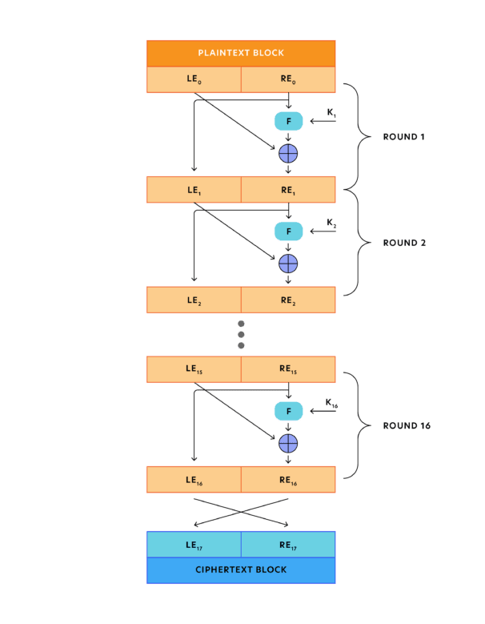
Feistel Cipher Structure:
Horst Feistel devised the Feistel cipher Based on concept of invertible product cipher

Slide 32
Input- plaintext block (2w bits)
L₀ and R₀
Process through n-rounds and combine to produce cipher text.
Each round ‘i’ has inputs L_{i-1} and R_{i-1,} which is derived from previous rounds and subkey k_{i}. (k_{i} derived from K).
Each k_{i} is different from each other.
Round function has the same structure.
Substitution is performed on the left half of the data. This is done by applying round function F to R_{i} and taking XOR of the output of the function and the L_{i.}
Round function has the same general structure and parameterized by the round subkey K_{i}

Slide 33
Following the substitution, a permutation is performed by interchanging the two halves of the data.
Implements Shannon’s S-P network concept
In particular, Feistel proposed the use of a cipher that alternates substitutions and permutations, where these terms are defined as follows:
Substitution: Each plaintext element or group of elements is uniquely replaced by a corresponding ciphertext element or group of elements.
Permutation: A sequence of plaintext elements is replaced by a permutation of that sequence. That is, no elements are added or deleted or replaced in the sequence, rather the order in which the elements appear in the sequence is changed

Slide 34
Feistel Cipher Design Elements:
Block size: larger block size means greater security but reduces E/D speed.
Key size: larger key size means greater security but reduces E/D speed.
Number of rounds: single round offers inadequate security but that multiple rounds offers greater security. (16 rounds)
Subkey generation algorithm: Greater complexity should lead to greater difficulty in cryptanalysis.
Round function: greater complexity should lead to greater difficulty in cryptanalysis.
Fast software encryption/decryption
Ease of analysis

Slide 35
Feistel Decryption Algorithm:
Same as the encryption process.
Ciphertext as input, but use the subkeys K_{i} in reverse order.
K_{n} First round, K_{n-1} in second round and K₁ in last round.
So, we need not to implement two different algorithms for encryption and decryption.
Notation for encryption LE_{i} and RE_{i}
Notation for decryption LD_{i} and Rd_{i}

Slide 36
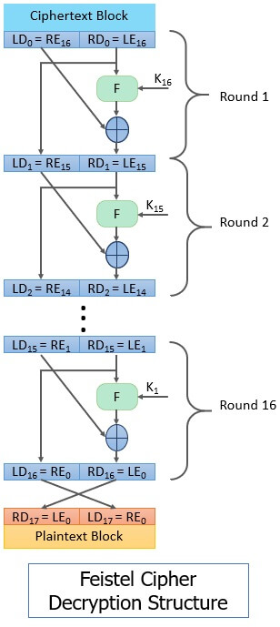

Slide 37
Intermediate value of the decryption process is equal to the corresponding value of the encryption process with two halves the value swapped.
i.e., output of ith encryption is LE_{i} ||RE_{i}
then, the corresponding (16-i) th decryption round is
RE_{i} || LE_{i or} RD_{16-i} || LD_{16-i}
After the last iteration of encryption process two halves of the output are swapped, so the cipher text is RE₁₆ || LE_{16.}(ciphertext)
This cipher text is the input of the decryption algorithm.
Input to the first round of the algorithm is RE₁₆ || LE₁₆ which is equal to the 32bit swap of the algorithm.
Output of the first round of the decryption process is equal to a 32-bit swap of the input to the sixteenth round of the encryption process.

Slide 38
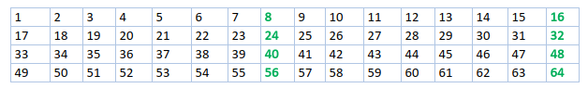
DES - DATA ENCRYPTION STANDARD
The Data Encryption Standard (DES) is a symmetric-key block cipher published by the National Institute of Standards and Technology (NIST).
DES is an implementation of a Feistel Cipher. It uses 16 round Feistel structure. The block size is 64-bit. Though, key length is 64-bit, DES has an effective key length of 56 bits, since 8 of the 64 bits of the key are not used by the encryption algorithm (function as check bits only).
We have mentioned that DES uses a 56-bit key. Actually, The initial key consists of 64 bits. However, before the DES process even starts, every 8th bit of the key is discarded to produce a 56-bit key. That is bit positions 8, 16, 24, 32, 40, 48, 56, and 64 are discarded.

Slide 39
Thus, the discarding of every 8th bit of the key produces a 56-bit key from the original 64-bit key.
DES is based on the two fundamental attributes of cryptography: substitution (also called confusion) and transposition (also called diffusion).
DES consists of 16 steps, each of which is called a round. Each round performs the steps of substitution and transposition.
In the first step, the 64-bit plain text block is handed over to an initial Permutation (IP) function.
The initial permutation is performed on plain text.
Next, the initial permutation (IP) produces two halves of the permuted block; saying Left Plain Text (LPT) and Right Plain Text (RPT).
Now each LPT and RPT go through 16 rounds of the encryption process.
In the end, LPT and RPT are rejoined and a Final Permutation (FP) is performed on the combined block
The result of this process produces 64-bit ciphertext.

Slide 40
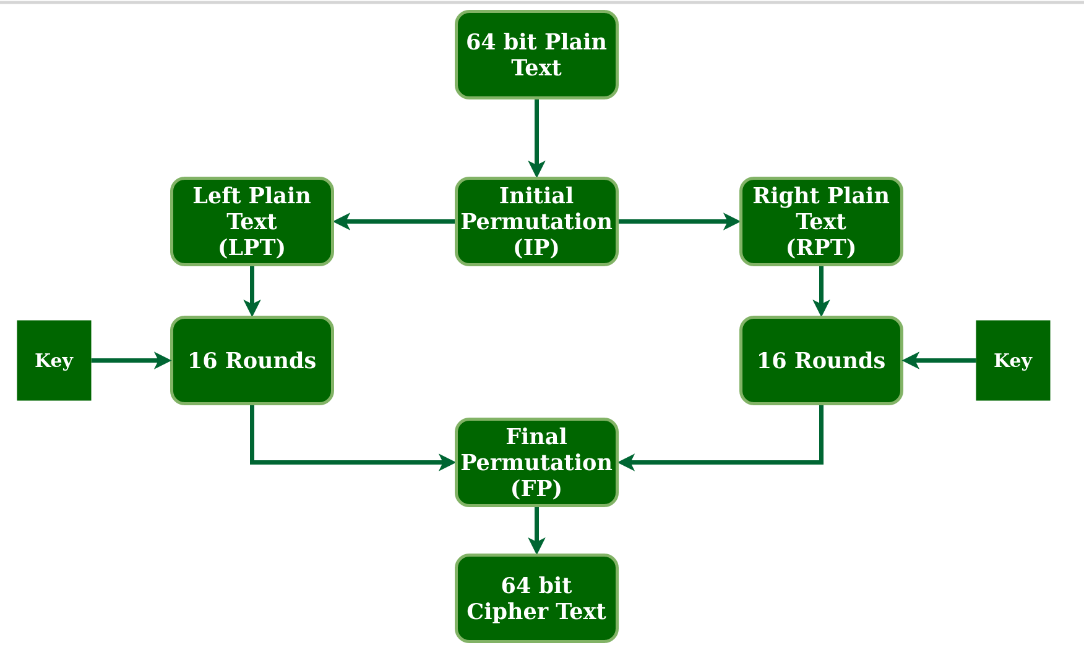

Slide 41
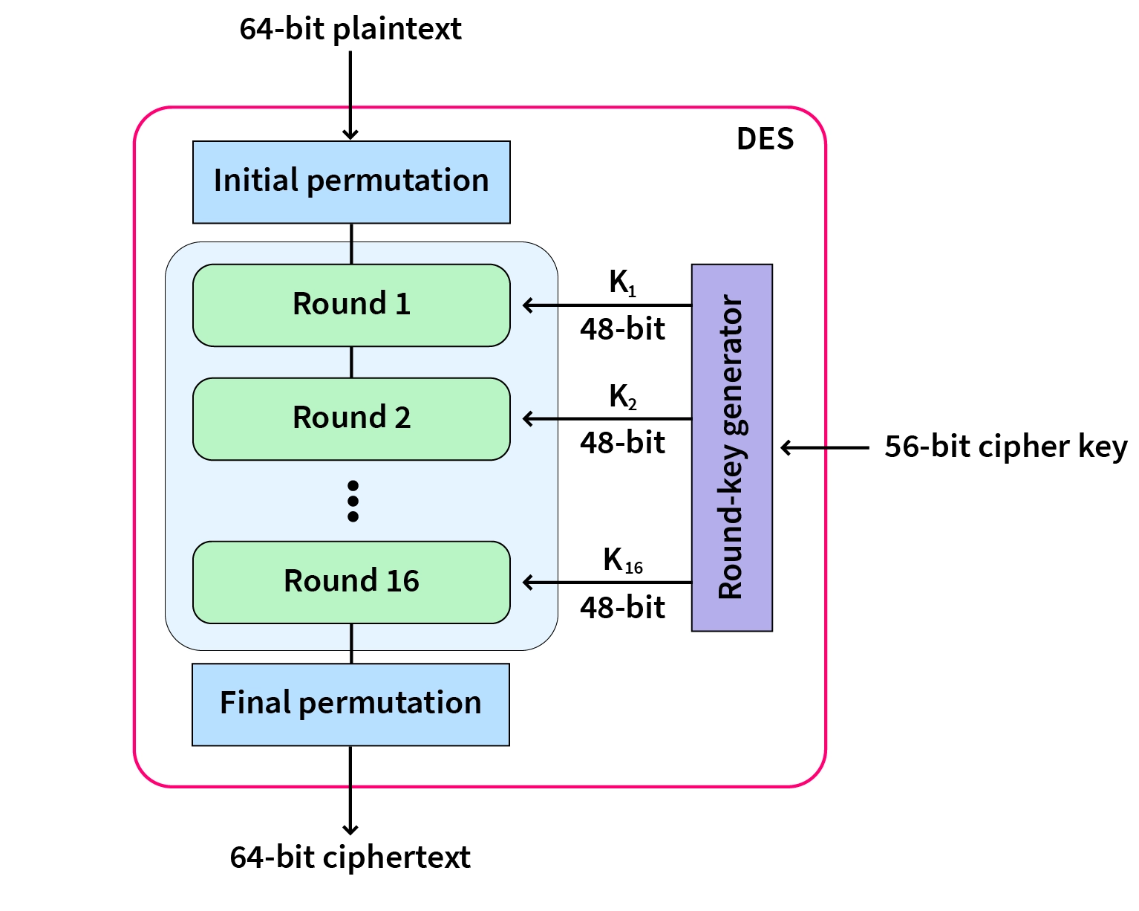

Slide 42
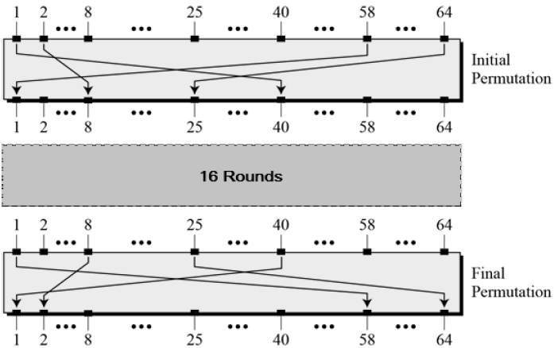
Since DES is based on the Feistel Cipher, all that is required to specify DES is −
Round function
Key schedule
Any additional processing − Initial and final permutation
1. Initial and Final Permutation
The initial and final permutations are straight Permutation boxes (P-boxes) that are inverses of each other.

Slide 43
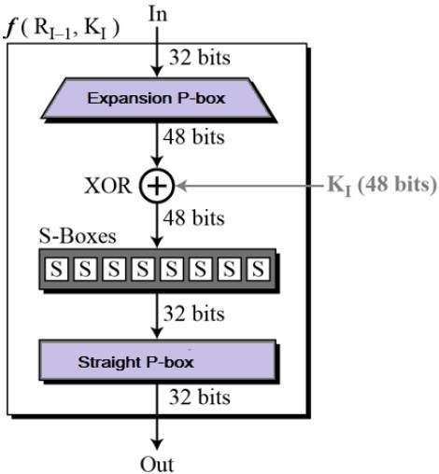
2. Round Function
The heart of this cipher is the DES function, f.
The DES function applies a 48-bit key to the rightmost 32 bits to produce a 32-bit output.

Slide 44

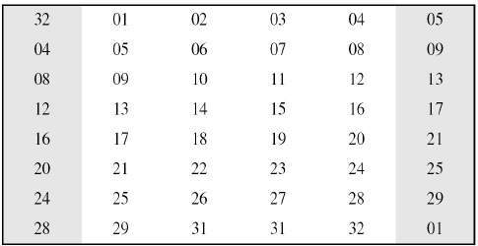
Expansion Permutation Box − Since right input is 32-bit and round key is a 48-bit, we first need to expand right input to 48 bits. Permutation logic is graphically depicted in the following illustration.
The graphically depicted permutation logic is generally described as table in DES specification illustrated as shown −

Slide 45
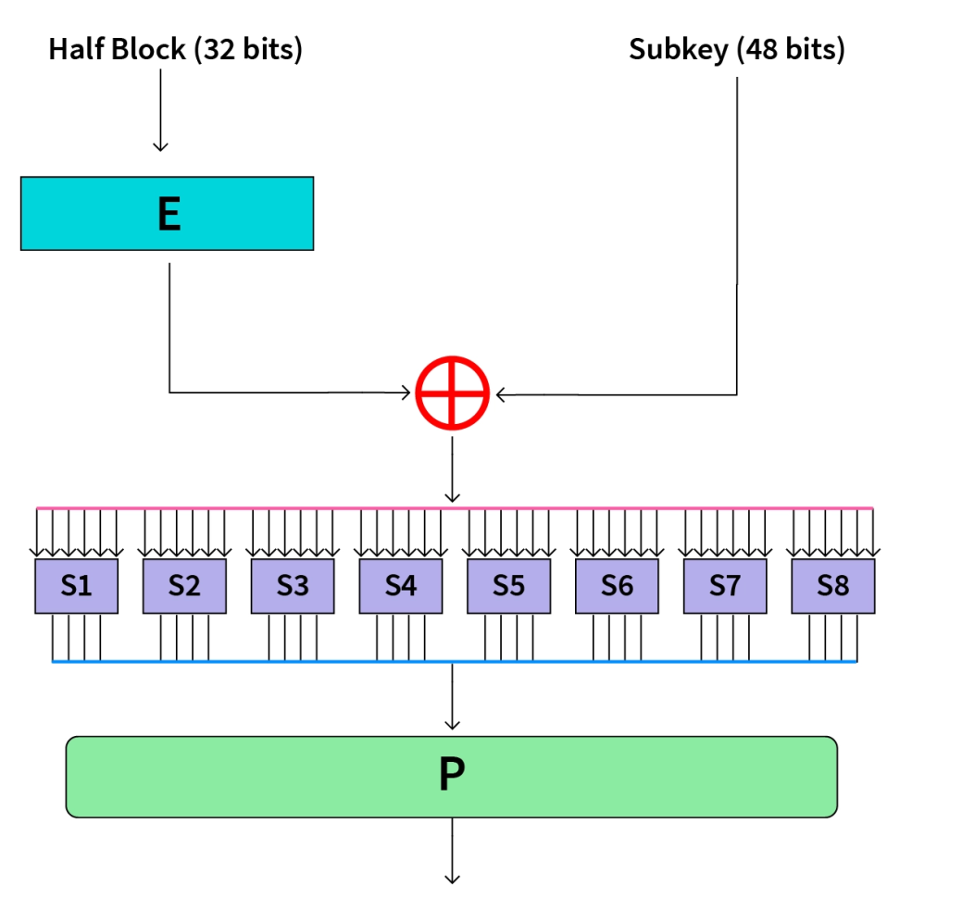
XOR (Whitener). − After the expansion permutation, DES does XOR operation on the expanded right section and the round key. The round key is used only in this operation.
Substitution Boxes. − The S-boxes carry out the real mixing (confusion). DES uses 8 S-boxes, each with a 6-bit input and a 4-bit output. Refer the following illustration −

Slide 46
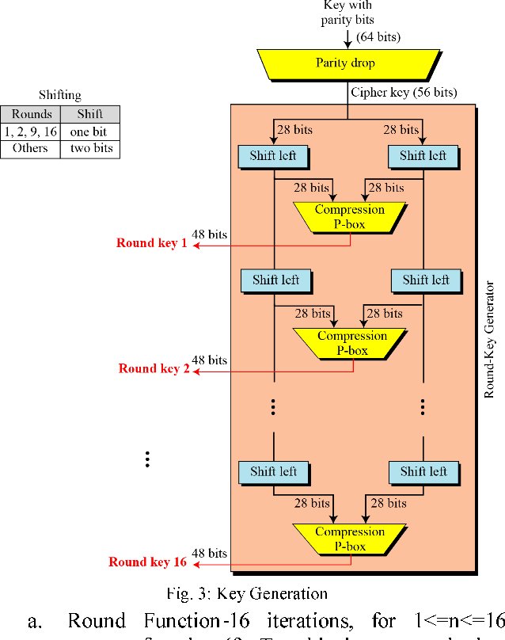
3. Key Generation
The round-key generator creates sixteen 48-bit keys out of a 56-bit cipher key.

Slide 47
DES Analysis :
Avalanche effect − A small change in plaintext results in the very great change in the ciphertext.
Completeness − Each bit of ciphertext depends on many bits of plaintext.
During the last few years, cryptanalysis have found some weaknesses in DES when key selected are weak keys. These keys shall be avoided.
DES has proved to be a very well designed block cipher. There have been no significant cryptanalytic attacks on DES other than exhaustive key search.

Slide 48
AES-Advanced Encryption Standard
Highly trusted encryption algorithm used to secure data by converting it into an unreadable format without the proper key.
It is developed by the National Institute of Standards and Technology (NIST) in 2001.
It is widely used today as it is much stronger than DES and triple DES despite being harder to implement.
AES encryption uses various key lengths (128, 192, or 256 bits) to provide strong protection against unauthorized access.
This data security measure is efficient and widely implemented in securing internet communication, protecting sensitive data, and encrypting files.
AES, a cornerstone of modern cryptography, is recognized globally for its ability to keep information safe from cyber threats.

Slide 49
AES is a Block Cipher.
The key size can be 128/192/256 bits.
Encrypts data in blocks of 128 bits each.
Working of The Cipher
AES performs operations on bytes of data rather than in bits.
Since the block size is 128 bits, the cipher processes 128 bits (or 16 bytes) of the input data at a time.
The number of rounds depends on the key length as follows :
N (Number of Rounds) | Key Size (in bits)
10 | 128
12 | 192
14 | 256

Slide 50
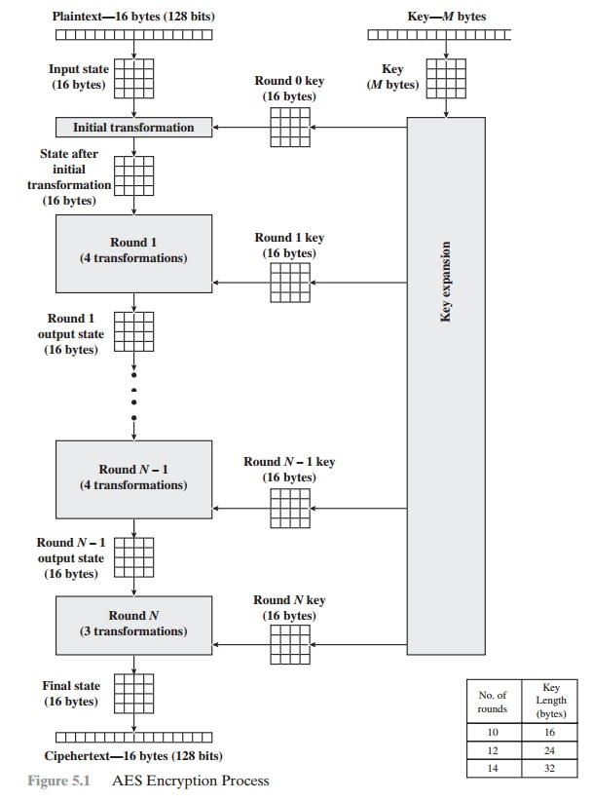

Slide 51
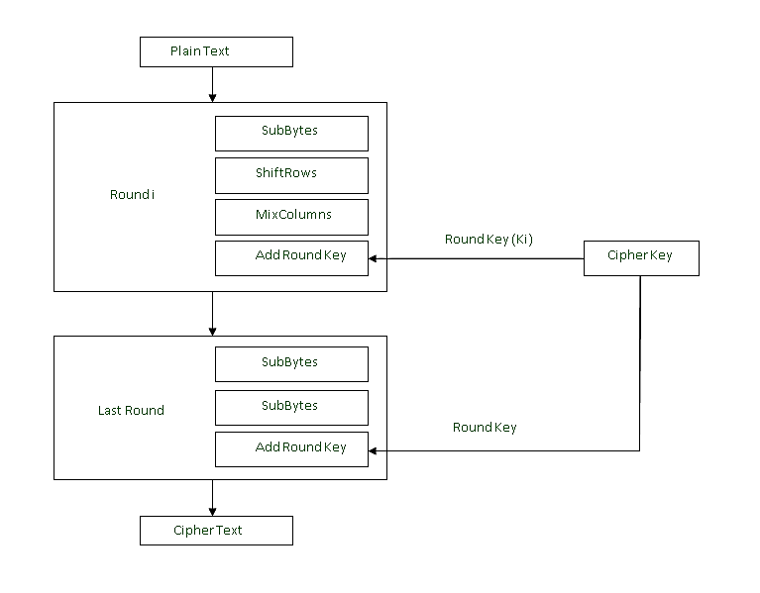

Slide 52
Encryption
AES considers each block as a 16-byte (4 byte x 4 byte = 128 ) grid in a column-major arrangement.
[ b0 | b4 | b8 | b12 |
| b1 | b5 | b9 | b13 |
| b2 | b6 | b10| b14 |
| b3 | b7 | b11| b15 ]
Each round comprises of 4 steps :
Sub Bytes
Shift Rows
Mix Columns
Add Round Key

Slide 53
Step1. Sub Bytes
This step implements the substitution.
In this step, each byte is substituted by another byte.
It is performed using a lookup table also called the S-box.
This substitution is done in a way that a byte is never substituted by itself and also not substituted by another byte which is a compliment of the current byte.
The result of this step is a 16-byte (4 x 4 ) matrix like before.
The next two steps implement the permutation.

Slide 54
Step2. Shift Rows
This step is just as it sounds. Each row is shifted a particular number of times.
The first row is not shifted
The second row is shifted once to the left.
The third row is shifted twice to the left.
The fourth row is shifted thrice to the left.
(A left circular shift is performed.)
[ b0 | b1 | b2 | b3 ] [ b0 | b1 | b2 | b3 ] | b4 | b5 | b6 | b7 | -> | b5 | b6 | b7 | b4 | | b8 | b9 | b10 | b11 | | b10 | b11 | b8 | b9 | [ b12 | b13 | b14 | b15 ] [ b15 | b12 | b13 | b14 ]

Slide 55
Step 3: Mix Columns
This step is a matrix multiplication.
Each column is multiplied with a specific matrix and thus the position of each byte in the column is changed as a result.
This step is skipped in the last round.
[ c0 ] =[ 2 3 1 1 ] [ b0 ] | c1 | = | 1 2 3 1 | | b1 | | c2 | =| 1 1 2 3 | | b2 | [ c3 ]= [ 3 1 1 2 ] [ b3 ]
Step 4: Add Round Keys
Now the resultant output of the previous stage is XOR-ed with the corresponding round key. Here, the 16 bytes are not considered as a grid but just as 128 bits of data.
After all these rounds 128 bits of encrypted data are given back as output. This process is repeated until all the data to be encrypted undergoes this process.

Slide 56
Decryption
The stages in the rounds can be easily undone as these stages have an opposite to it which when performed reverts the changes. Each 128 blocks goes through the 10,12 or 14 rounds depending on the key size.
The stages of each round of decryption are as follows :
Add round key
Inverse MixColumns
ShiftRows
Inverse SubByte

Slide 57
Applications of AES
Wireless security: AES is used in securing wireless networks, such as Wi-Fi networks, to ensure data confidentiality and prevent unauthorized access.
Database Encryption: AES can be applied to encrypt sensitive data stored in databases. This helps protect personal information, financial records, and other confidential data from unauthorized access in case of a data breach.
Secure communications: AES is widely used in protocols such as internet communications, email, instant messaging, and voice/video calls. It ensures that the data remains confidential.
Data storage: AES is used to encrypt sensitive data stored on hard drives, USB drives, and other storage media, protecting it from unauthorized access in case of loss or theft.
Virtual Private Networks (VPNs): AES is commonly used in VPN protocols to secure the communication between a user’s device and a remote server. It ensures that data sent and received through the VPN remains private and cannot be deciphered by eavesdroppers.
Secure Storage of Passwords: AES encryption is commonly employed to store passwords securely. Instead of storing plaintext passwords, the encrypted version is stored. This adds an extra layer of security and protects user credentials in case of unauthorized access to the storage.
File and Disk Encryption: AES is used to encrypt files and folders on computers, external storage devices, and cloud storage. It protects sensitive data stored on devices or during data transfer to prevent unauthorized access.

Slide 58
Triple DES
The speed of exhaustive key searches against DES after 1990 began to cause discomfort amongst users of DES.
However, users did not want to replace DES as it takes an enormous amount of time and money to change encryption algorithms that are widely adopted and embedded in large security architectures.
The pragmatic approach was not to abandon the DES completely, but to change the manner in which DES is used.
This led to the modified schemes of Triple DES (sometimes known as 3DES).
Incidentally, there are two variants of Triple DES known as 3-key Triple DES (3TDES) and 2-key Triple DES (2TDES).

Slide 59
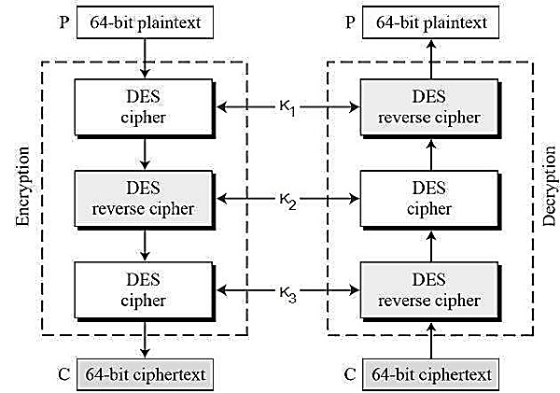
3-KEY Triple DES
Before using 3TDES, user first generate and distribute a 3TDES key K, which consists of three different DES keys K1, K2 and K3.
This means that the actual 3TDES key has length 3×56 = 168 bits.

Slide 60
The encryption-decryption process is as follows −
Encrypt the plaintext blocks using single DES with key K1.
Now decrypt the output of step 1 using single DES with key K2.
Finally, encrypt the output of step 2 using single DES with key K3.
The output of step 3 is the ciphertext.
Decryption of a ciphertext is a reverse process. User first decrypt using K3, then encrypt with K2, and finally decrypt with K1.
Due to this design of Triple DES as an encrypt–decrypt–encrypt process, it is possible to use a 3TDES (hardware) implementation for single DES by setting K1, K2, and K3 to be the same value. This provides backwards compatibility with DES.
Second variant of Triple DES (2TDES) is identical to 3TDES except that K3 is replaced by K1. In other words, user encrypt plaintext blocks with key K1, then decrypt with key K2, and finally encrypt with K1 again. Therefore, 2TDES has a key length of 112 bits.
Triple DES systems are significantly more secure than single DES, but these are clearly a much slower process than encryption using single DES.

Slide 61
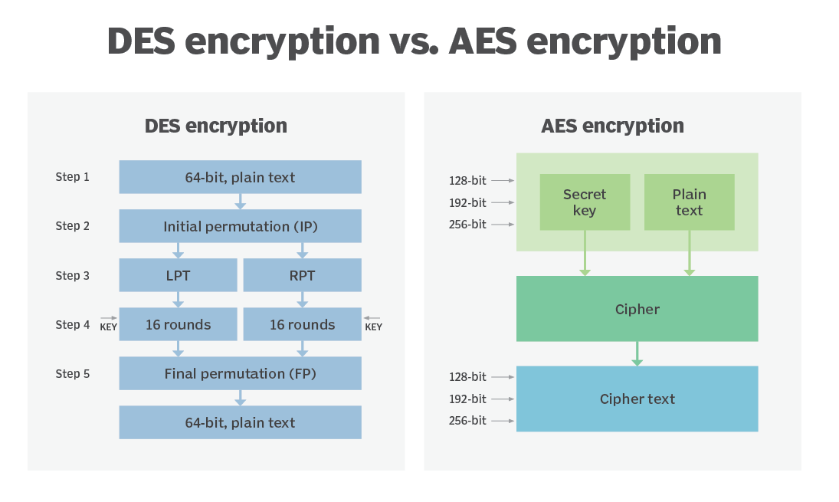
Difference between AES and DES Ciphers
Both DES and AES are symmetric-key block ciphers that are used in encryption where just one key (the secret key) is utilized to encode and decode electronic data. The key must be exchanged between the organizations communicating using symmetric encryption so that it can be utilized in the decryption process.

Slide 62
Key | AES | DES
Definition | AES stands for Advanced Encryption Standard. | DES stands for Data Encryption Standard.
Key Length | Key length varies from 128 bits, 192 bits to 256 bits. | Key length is of 56 bits.
Rounds of Operations | Rounds per key length: 128 bits - 10 192 bits - 12 256 bits – 14 | 16 rounds of identical operations.
Network | AES structure is based on substitution-permutation network. | DES structure is based on Feistal network.
Security | AES is de-facto standard and is more secure than DES. | DES is weak, however 3DES (Triple DES) is more secure than DES.
Rounds | The operation rounds involved in AES encryption are Byte Substitution, Shift Row, Mix Column, and Key Addition. | Expansion, XOR operation with round key, Substitution, and Permutation are the rounds used in DES encryption
Size | AES can encrypt 128 bits of plain text. | DES can encrypt 64 bits of plain text.
Derived from | AES is derived from Square cipher. | DES is derived from Lucifer cipher.
Designed By | AES was designed by Vincent Rijmen and Joan Daemen. | DES was designed by IBM.
Known attacks | No known attacks. | Brute-force, Linear crypt-analysis and Differential crypt-analysis.
Encryption | AES can encrypt plain text up to 128 bits. | DES can encrypt 64 bits of plain text.

